Slide 1
Personal Practical Cybersecurity for Modern Times

Slide 2
Awareness is the best Digital Defense
“It’s difficult to ignore how commonplace large-scale hacks have become, and there’s no sign that this form of criminality is going to die off. There is no defense that’s 100 percent capable of blocking any kind of attack; criminals will always find a way to exploit even the smallest weakness. Although it’s not easy, the best way to stay safe online is to be aware of the threats, and aware of what can be done to safeguard against those threats.
Online security is like paying for insurance, or going to the dentist. It doesn’t seem that important, until it is. It’s not enough to simply opt-in to the forms of protection we’re offered by various sites and services. Knowing what kind of attacks these protections defend us from — and what they don’t — is the only way to take charge of your own security.”
Brad Jones, DigitalTrends, 2017 https://www.digitaltrends.com/computing/why-2-factor-security-is-flawed/

Slide 3
Phishing
Of course you know about not clicking suspicious email links which are attempting to harvest your username/password via a fake but realistic-looking login page.
This is called “phishing”, or if they’re going after you because of your role/title, “spear phishing”.
But what if they already know your username and password?

Slide 4
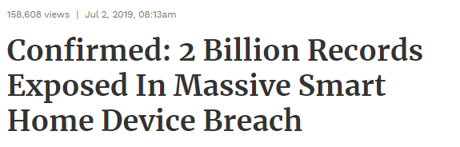
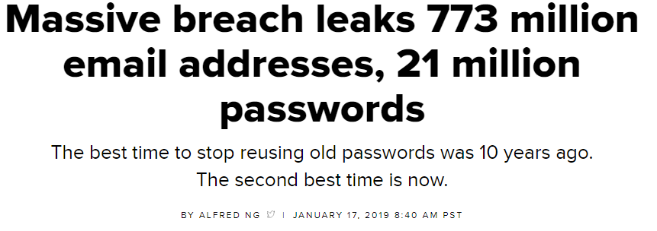
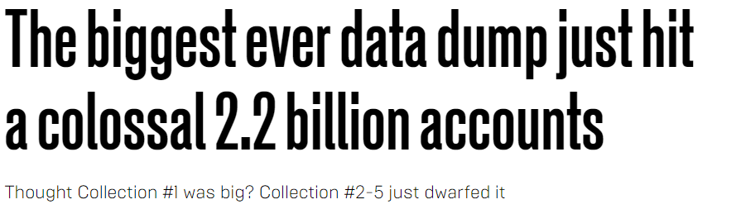
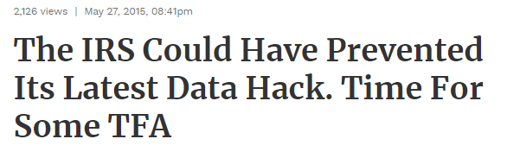
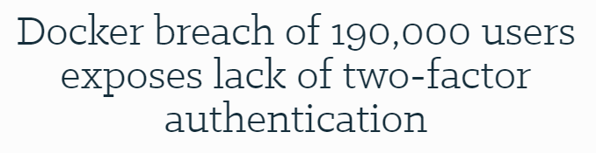
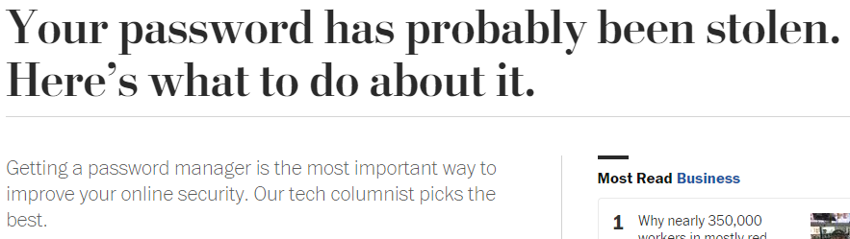
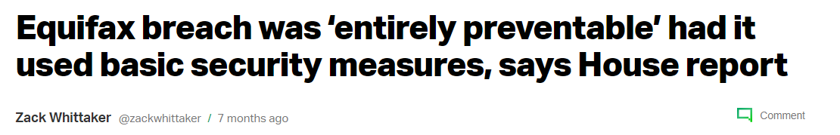
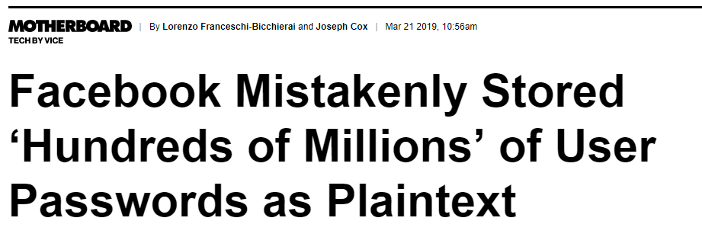
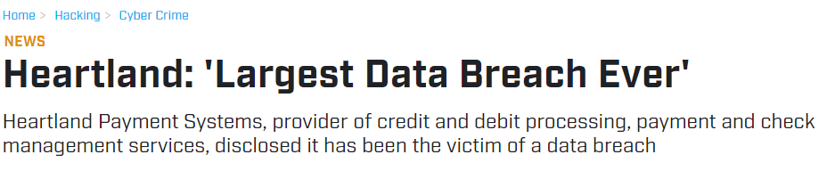
Don’t ever re-use passwords.
Yep, a new password for every login. Seriously.

Slide 5
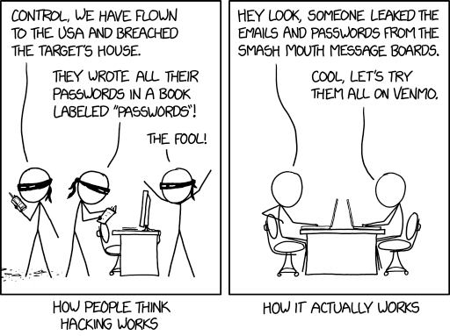
Password length and complexity are useless once some website or service leaks your email and password.

Slide 6
Password Hygiene
Has your email been part of any password leaks? haveibeenpwned.com
Spoiler alert: Almost Certainly
“People take lists like these that contain our email addresses and passwords then they attempt to see where else they work. The success of this approach is predicated on the fact that people reuse the same credentials on multiple services.” –Troy Hunt, haveibeenpwned.com

Slide 7
Your Email Account > Your Bank Account
Having your email hacked can be worse than having your bank account hacked.
Your email is a single point of failure.

Slide 8
Mobile Phones
Lock your phones, set it to automatically lock
Your phones = your email
Your email = reset of any of your passwords
therefore
Your phone = all of your accounts

Slide 9
Password Hygiene
True now and always:
Password length > Password complexity
Policies of high password complexity and frequent changes lead directly to bad habits
Password uniqueness > Password length
Passwords alone are terrible security

Slide 10
You Should Use a Password Manager
Basic idea: You have one unique super password to unlock everything else.
Obviously, don’t ever re-use it.
Pro: All your passwords are super long, super strong, unique, and available to you anywhere
Con: forget the one unique super password despite typing it in all the time? They cannot decrypt your passwords for you.

Slide 11
Password Managers
These are popular, secure, and inexpensive:
LastPass
1Password
Dashlane
KeePassX
Browsers have password features – not recommended because of lack of features, also because of their integration with the very accounts they are supposed to protect

Slide 12
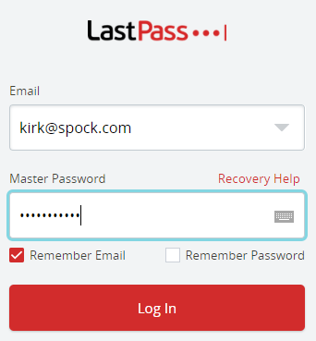
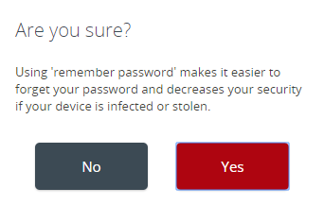
Password Managers
Exchange all your passwords for a single super password.
DO NOT set your single super password to be “remembered”, ever! Type it in, every time.

Slide 13
Password Managers
The password manager you choose should have the following options:
Can import from browser-stored passwords
Allow to easily generate, retrieve, and paste into a website on desktop or mobile
Warn you if you’re re-using the same password
Use TFA/MFA to access your passwords

Slide 14
What is Two Factor Authentication (TFA)
Passwords alone are a terrible security method
TFA or MFA (Two-factor or Multi-factor) authentication is something aside from a password that allows a website to confirm you are you.

Slide 15
Use TFA for Every Account You Can
Email, Google/iCloud/Microsoft
Office365 and GSuite both have strong TFA options
Modern Banking/Financial/Bill Payment
Banks are still pretty bad about TFA, especially small ones.
Cloud storage/assets, Github, Bitbucket
Social media, e-commerce, Gaming and Streaming
Government, public service, utility providers
Want to know if a site supports TFA? twofactorauth.org or just got to the security settings/menu and see. Most do.

Slide 16
TFA is not new concept…
… but implementation is still developing and the industry is still trying to overcome consumers’ desire to be ignorant and stubborn.
Asymmetric encrypted hardware key algorithms have been around since 1970s, some weren’t declassified until late 90s
The RSA algorithm patent was made public domain in 2000
The first driverless, one-touch auth USB device in 2008
Google provided TFA to all accounts as early as 2010

Slide 17
Common TFA/MFA Types
Text message (SMS)
Software-based authenticators
Hardware-based authenticators

Slide 18
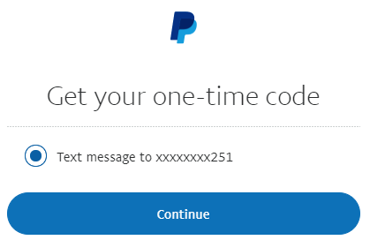

Text-Message (SMS) Based Authentication
After you log in, the website sends you an SMS to a phone number you have previously stored with them.
You type in the number within a certain amount of time, and the website knows it was you who received the text message.

Slide 19
Vulnerabilities in Cell Carriers
Man-in-the-middle SS7 telecom protocol attacks, SIM card swapping/cloning, and good old fashioned social engineering via customer support, have made this type of TFA obsolete and unsecure.
Almost every cell network around the world uses SS7. High profile banking hacks in the UK have raised awareness of this.
SS7 hack explained: what can you do about it? https://www.theguardian.com/technology/2016/apr/19/ss7-hack-explained-mobile-phone-vulnerability-snooping-texts-calls

Slide 20
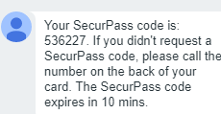
SMS-Based Scam Tactics
“I’m going to send you a secure code to make sure you’re not a scammer”
A common tactic on listing sites like Craigslist, Ebay, etc. They’re trying act as you to your cell carrier, tricking you into giving them a real code.
Received one you didn’t ask for? Someone may be trying to access an account of yours.
If you are ever sent a code via SMS, NEVER PROVIDE IT TO ANYONE.
They may be abusing the phone portability system that allows you to keep your phone number when you transfer cell providers.
This is an actual scam!

Slide 21
Text-Message (SMS) Based Authentication
If a site offers another option besides SMS TFA, use it.
Unfortunately, many banks ONLY provide this option.
SMS-based authentication is much better than no TFA.
Better than nothing, but not better.
Yahoo and Reddit have each been breached after they were targeted by SMS-based TFA. In each case, the hackers targeted specific admins and their phones, intercepted the text messages and/or changed their passwords.

Slide 22
Email-Based Authentication
Email authentication’s vulnerability concept is similar to SMS-based authentication.
Compromise the email account, and the “other factor” is compromised as well via password reset, etc.
Also, Google and Apple offer integrated SMS in email, so SMS sent to your phone is visible in email. Same problem.
Better than nothing, but not better.

Slide 23
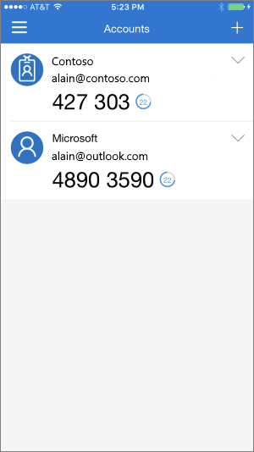
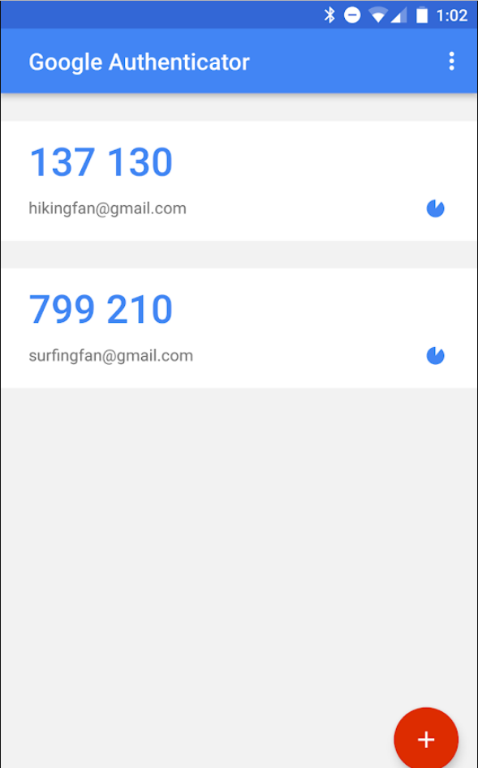

Software-Based Authentication
One-Time, Time-based Password Algorithm
Given an initial secret, your phone can generate a unique code that changes at intervals, forever.
The website uses the shared key to verify the same code.

Slide 24
Software-Based Authentication
An Authenticator “app” for your phone generates a number which you type in to the website, or approve via a push notification.
This is far more secure than text-message (SMS) based authentication.
Your phone holds the key. Which means if you lose your phone, you’ll need a backup method.

Slide 25
Software-Based Authentication Mobile Apps
Google Authenticator
Microsoft Azure Authenticator
LastPass Authenticator
Authy: multiplatform free service for software TFA
Enterprise mobile apps:
Symantec VIP, RSA, Duo

Slide 26
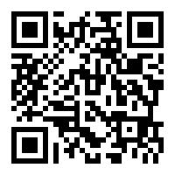
Software-Based Authentication Setup
When you set up a TFA App with a new website or account, you’ll be provided a QR code and/or long string you only see once, SAVE IT SECURELY for future convenience.
You can use the same QR Code or string to transfer phones or create backup devices with the same TFA code generation.
You’ll also be given a set of “backup” one-time use codes. STORE THESE SECURELY AND SEPERATELY. You may need to use one in a pinch to gain access if you’ve lost your phone.

Slide 27
Multi-factor password alternatives
Complimentary alternatives to passwords have been pushed by Microsoft (and others) for using numeric PIN to access a cert on your device.
The PIN only works on that device with that cert. New device? No cert, PIN doesn’t work.
Microsoft Hello is a push to eliminate recurring access via passwords that work every where with PINs (or biometric data, or other hardware TFA) linked to a device cert.
Initial sign-in with a username/password to set up?

Slide 28
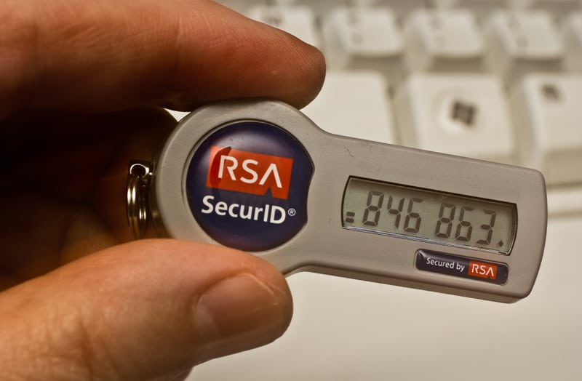
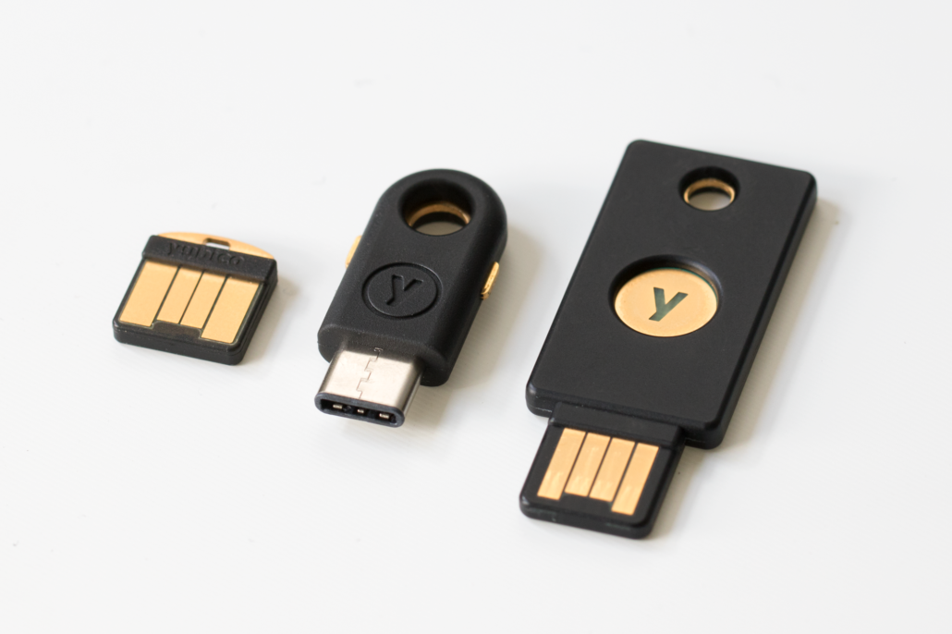
Hardware-Based Authentication
Very similar to Software-based authentication, but not on a phone or app, rather, generated by a simple microprocessor that generates codes based on a pre-known secret.
Or, a hardware key that integrates with software to provide a TFA presence only when plugged into a USB port on your device.

Slide 29
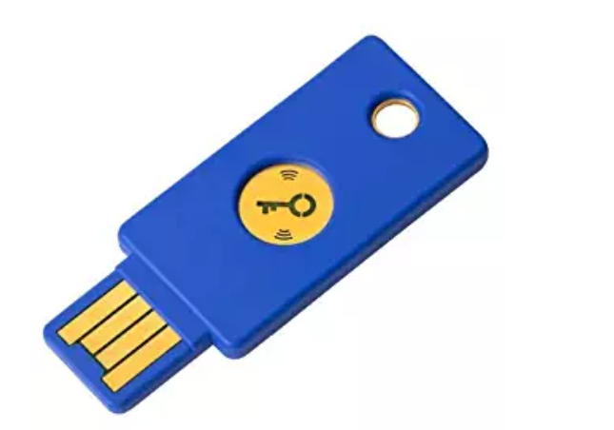
Hardware-Based Authentication
Ties physical security (your chain of keys) to digital security, not something you may be used to. Will require you to change habits.
You can (and should!) easy create duplicate keys for the same service with the same secrets, store one in a safe at home, for example.
Pictured: Yubikey ($25 on Amazon)

Slide 30
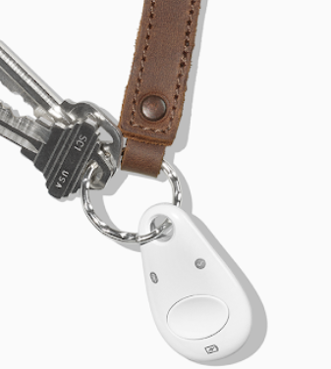
Hardware-Based Authentication
You need TFA for your phone too.
Some hardware-based keys support Bluetooth or NFC, or, carry a USB-C to USB adapter.
Google’s Titan (right) is the only option right now with Bluetooth and NFC on the latest standard.
Again, this is still an immature industry.

Slide 31
Can’t Trust Google Implicitly, But
Google offers a free platform utilizing hardware TFA for “anyone at risk of targeted attacks – like journalists, activists, business leaders, and political teams.“ https://landing.google.com/advancedprotection/
“Google has not had any of its 85,000+ employees successfully phished since early 2017, when it began requiring all employees to use physical Security Keys in place of passwords and one-time codes.” https://krebsonsecurity.com/2018/07/google-security-keys-neutralized-employee-phishing/

Slide 32
Personal Practical Cybersecurity
The TFA industry and various sites’ implementations are still immature and is advancing quickly, hindered by the cost and sophistication but mostly hindered by user resistance to change.
This is not an excuse.
Take steps now!

Slide 33
More Reading
How Russian Cyberpower Invaded the U.S. https://www.nytimes.com/2016/12/13/us/politics/russia-hack-election-dnc.html
Your password has probably been stolen. Here’s what to do about it. https://www.washingtonpost.com/technology/2018/07/12/your-password-has-likely-been-stolen-heres-what-do-about-it/
How to protect yourself from 'spear phishing' hacking technique https://phys.org/news/2018-07-spear-phishing-hacking-technique.html
Reddit Breach Highlights Limits of SMS-Based Authentication https://krebsonsecurity.com/2018/08/reddit-breach-highlights-limits-of-sms-based-authentication/
This is why you shouldn’t use texts for two-factor authentication https://www.theverge.com/2017/9/18/16328172/sms-two-factor-authentication-hack-password-bitcoin
Two-Factor Authentication: Who Has It and How to Set It Up https://www.pcmag.com/feature/358289/two-factor-authentication-who-has-it-and-how-to-set-it-up
Hackers beat 2-factor protection with automated phishing attacks https://mashable.com/article/hackers-beat-two-factor-authentication-2fa-phishing
Creating the Unphishable Security Key: How the FIDO U2F security key and YubiKey stop phishing and man-in-the-middle attacks www.yubico.com/2017/10/creating-unphishable-security-key/
What is two-factor authentication, and which 2FA solutions are best?https://www.pcworld.com/article/3225913/what-is-two-factor-authentication-and-which-2fa-apps-are-best.html
The Limits of SMS for 2-Factor Authentication https://krebsonsecurity.com/2016/09/the-limits-of-sms-for-2-factor-authentication/
Major SMS security lapse is a reminder to use authenticator apps instead https://www.theverge.com/2018/11/16/18098286/vovox-security-breach-two-factor-authentication-2fa-codes-exposed
Metro Bank targeted with 2FA-bypassing SS7 attacks https://www.itpro.co.uk/security/32898/metro-bank-targeted-with-2fa-bypassing-ss7-attacks
Secure password-less sign-in for your Microsoft account using a security key or Windows Hello https://www.microsoft.com/en-us/microsoft-365/blog/2018/11/20/sign-in-to-your-microsoft-account-without-a-password-using-windows-hello-or-a-security-key/

